Slide 1
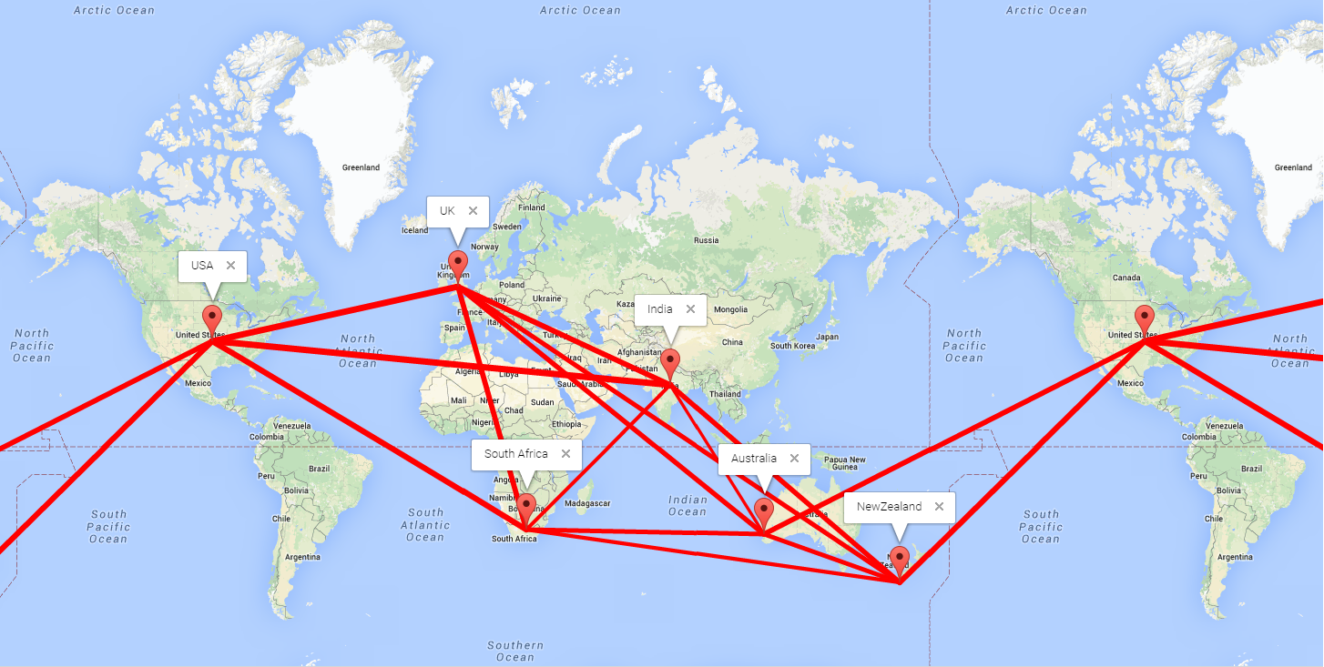
Correlations in the top right corner of Table 2
Correlations in order: USA>UK>NZ>RSA>Aus>India
Topics of the most interest in the USA tend to be of interest everywhere else

Slide 2
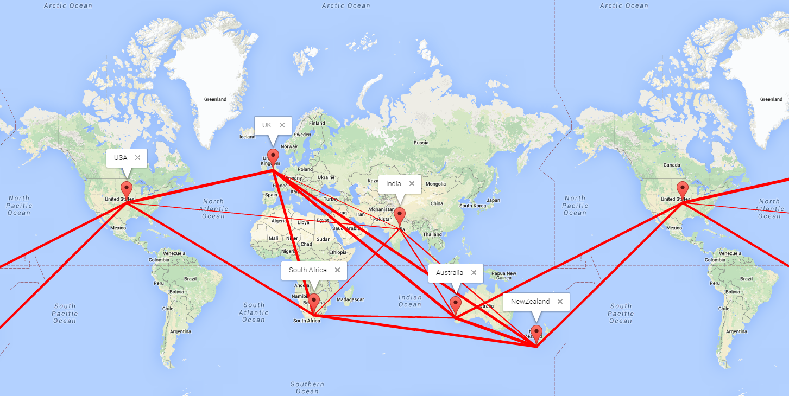
Correlations in the bottom left corner of Table 2
Correlations in order: USA<UK<NZ<RSA<Aus<India
Topics of the most interest in India tend to be of less interest elsewhere

