Slide 1
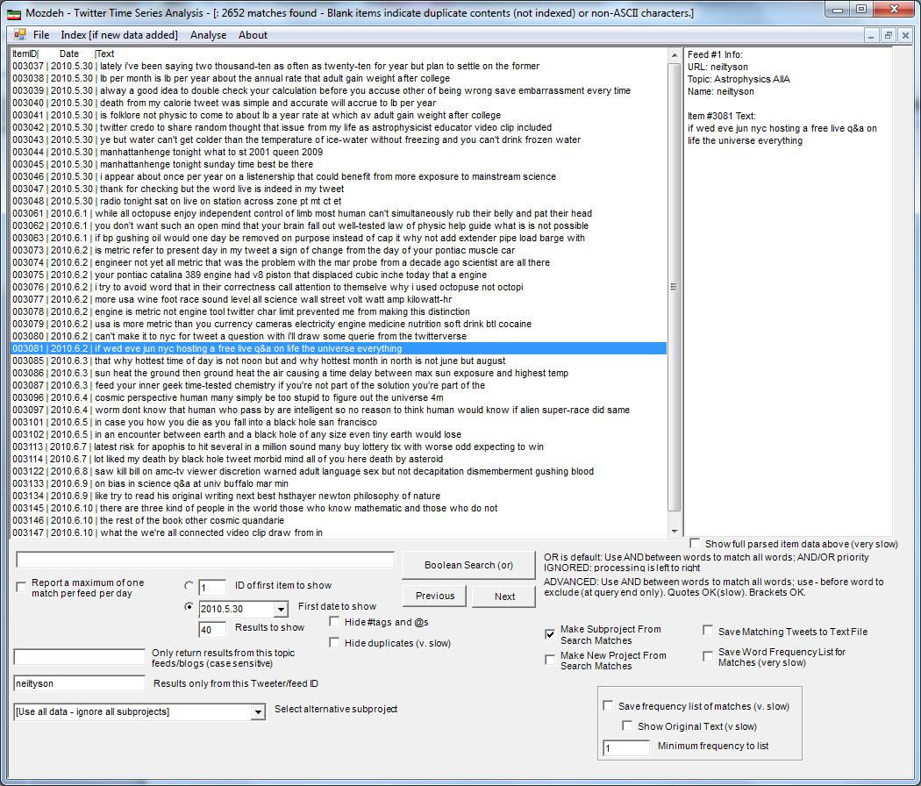
This saves all tweets from @neiltyson as a new subproject
Twitter account name
Save as new subproject
Use all data

Slide 2
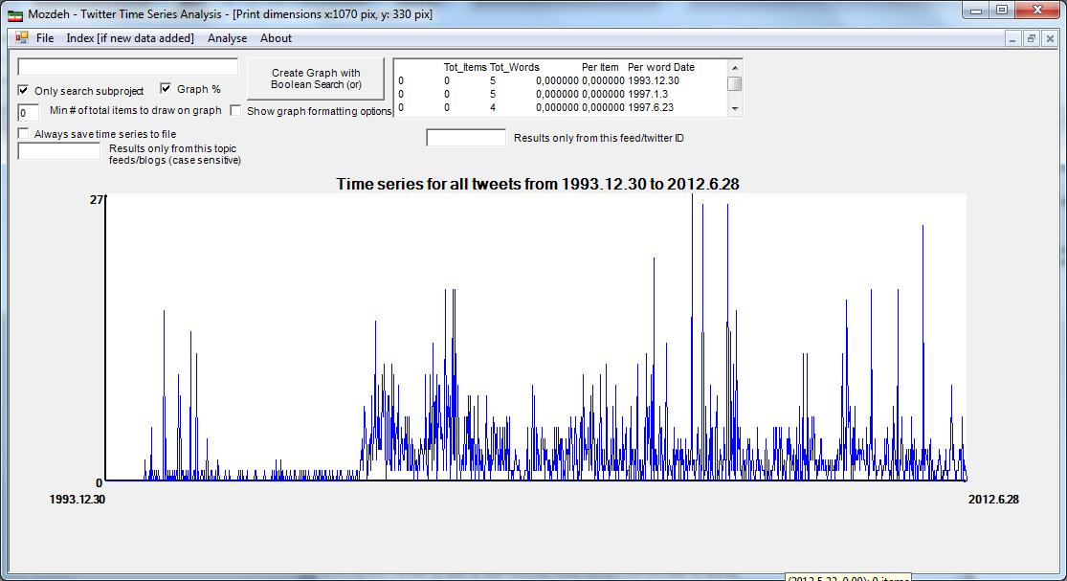
And when you do an empty search in Time Series Analysis with that subproject, you’ll get a time serie of all tweets by @neiltyson
And if you click on the spikes you’ll get the tweets from that date

