Slide 1
Analyzing Twitter conversations with Webometric Analyst
By Kim Holmberg
http://kimholmberg.fi/

Slide 2
Removing Retweets
Collect the tweets (for how to collect tweets, see http://lexiurl.wlv.ac.uk/searcher/twitter.htm) and then remove retweets, as these can be argued to not indicate conversations between Twitter users.
To remove the pure retweets (i.e. Tweets starting with RT)
EITHER: open the file containing the tweets in Excel and sort the data according to the tweet content column. Then delete the rows starting with RT;
OR: select Split file into two based on matching text from the Text menu in Webometric Analyst, select the file containing the tweets, and enter ”<tab>RT” as the text to split the file on, where <tab> represents a tab key and the quotes should not be typed. Then use the ”noMatch” file created by this process, which will have the retweets filtered out.

Slide 3
Removing Via tweets
To remove any occurences where the tweet has been sent ”via @username”
EITHER: open the file in Notepad Plus Plus (or Notepad, but Notepad Plus Plus is much faster for this kind of task) and then Replace text strings like ”via @” with for instance ”via _AT_”.
OR: select Replace text A with text B everywhere in file from the Text menu in Webometric Analyst, select the file containing the tweets, and enter ”via @” as the text to find and ”via _AT_ as the text to replace. Then use the ” _changed” file created by this process.
In the next step extracting the usernames from the tweets these retweets will not be included, because Webometric Analyst uses the @-sign as an identifier of usernames.

Slide 4
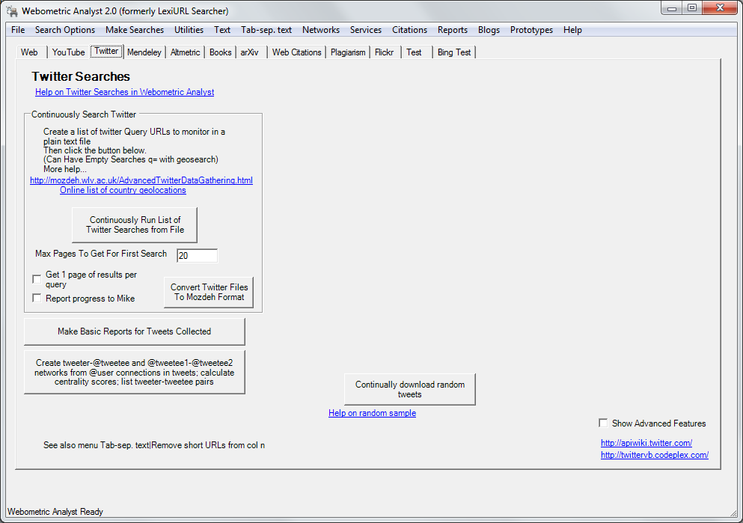
Open Webometric Analyst and go to the Twitter tab.
Click on the button saying ”Create tweeter-@tweetee and ...”

Slide 5
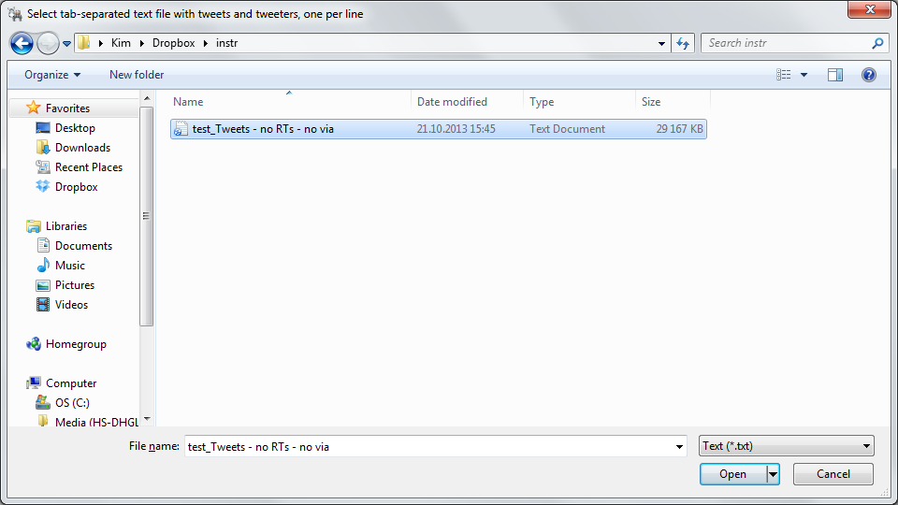
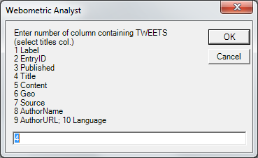
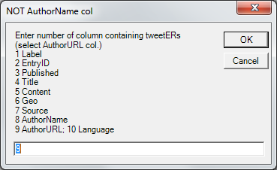
Select the file from which you have removed the retweets
Then select the column containing the tweets ...
... and the column containing the author URLs

Slide 6
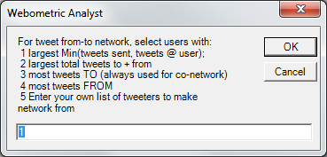
Depending on your research goals, select what kind of network you want to create from the tweeter – tweetee connections
1. For each user, this calculates the minimum of the number of tweets sent by them, and the number of tweets sent to them. The tweeters are then selected with the largest of these minimum values.
2. For each user, this calculates the number of tweets sent by them and adds it to the number of tweets sent to them. The tweeters are then selected with the largest of these values.
3. For each user, this calculates the number of tweets sent to them. The tweeters are then selected with the largest of these values.
4. For each user, this calculates the number of tweets sent by them. The tweeters are then selected with the largest of these values.

Slide 7
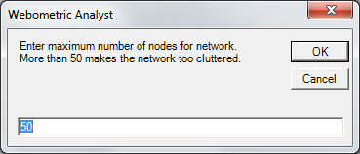
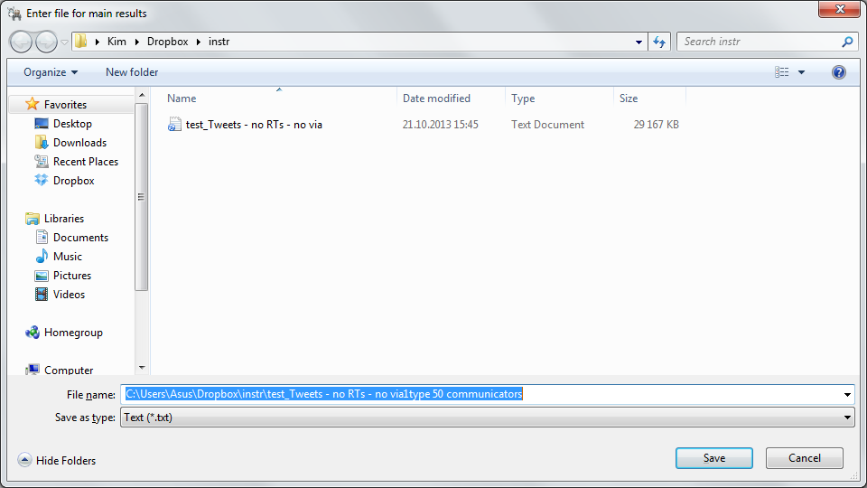
Enter the maximum number of nodes for the network. Depending on your research goals and if you continue to analyse the network in Gephi or Pajek you can increase the number of nodes from the suggested 50.
Note: If you put a very large max here, such as 20,000, you might get a system-out-of-memory-error when WA is calculating either the network or the information files. To fix this, try fewer nodes or a computer with more memory (RAM). The TweeterTweetee-file should always be OK.
Next enter a filename for the results

Slide 8
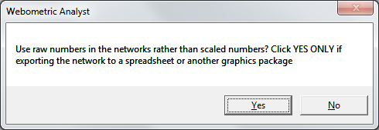
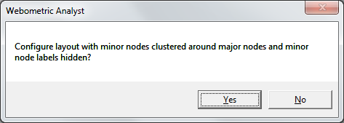
Depending on what you’ll do in the next steps of your project select to use either raw numbers (click YES) or the scaled numbers (to view the network mainly in Webometric Analyst Network) (click NO).
Now Webometric Analyst will draw the network and asks if you want it to cluster minor nodes around major nodes and hide their labels. If you continue your analysis with Gephi or Pajek, this step doesn’t influence your data.

Slide 9
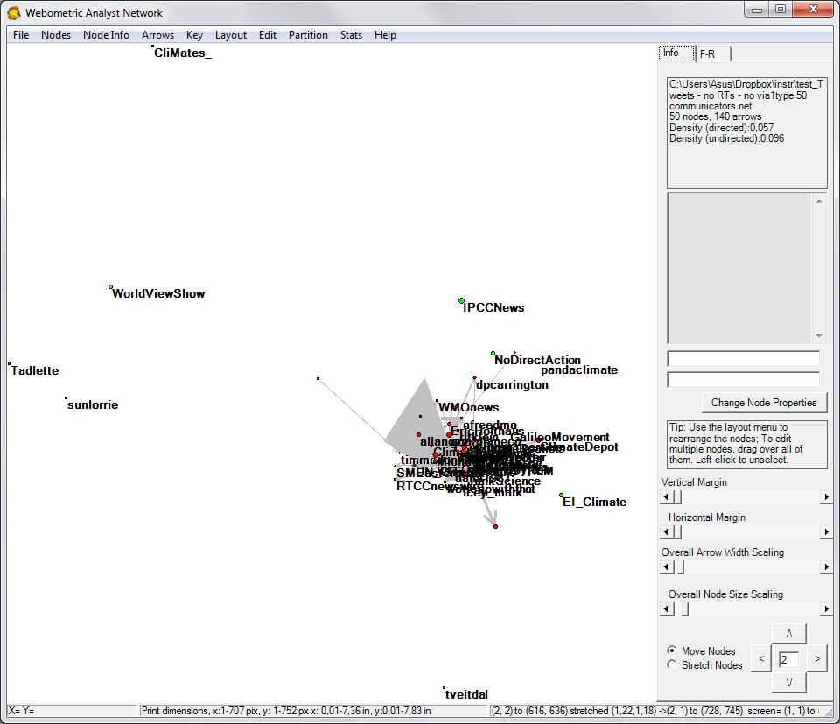
In this final step Webometric Analyst draws the network.
To learn about the functions in this network visualization tool, consult the manual for Webometric Analyst Network.
http://webometrics.wlv.ac.uk/networkhelp/

Slide 10
This analysis resulted in the following data files:
The ..._centrality.txt file contains the (social network analysis) centrality scores of the nodes (=usernames). Both Arrow.Info –files are used by the built-in network visualization tool in Webometric Analyst.
The ...communicators.net file contains a network in which the nodes are Twitter users and the arrows between them have thicknesses proportional to the number of tweets sent from the arrow source node to the arrow target node.
The ...cotweeted.net file contains a network in which the nodes are Twitter users and the lines between them have thicknesses proportional to the number of tweets sent simultaneously to both of them ( e.g., ”@jim @naz morning” is a co-tweet between jim and naz, no matter who sent the tweet).
These .net files can be analyzed in WA Network, Gephi or Pajek. For many research goals choosing the appropriate type of network from the 5 options earlier and analysing the resulting network files in WA Network or Gephi would be enough. However, if you want to use the number of connections between the tweeters and tweetees (instead of using combinations of the number of tweets sent and received) you’ll need to continue with the ...TweeterTweetee.txt file.

Slide 11
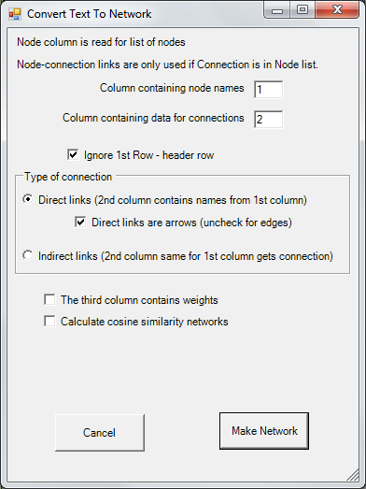
The ...TweeterTweetee.txt file contains a list of the tweet sources and targets. If a tweet is sent to multiple targets, then there is one line per source-target pair. This file can be used to create a simple network of the conversational connections in the tweets. You can use the BibExcel co-word analysis manual to create the network.
In the Networks menu there’s a function called: Convert columns of text into co-occurrence or link network (Pajek). This will convert the TweeterTweetee file into a network for people that either send or receive a tweet.

